Slide 1

Chicago Taxi Trips
MSDS 7330 Term Paper – Group D
Josh Balson
Cam Lu
Hieu Nguyen
Notes:
To change the image on this slide, select the picture and delete it. Then click the Pictures icon in the placeholder to insert your own image.

Slide 2
Abstract
The purpose of this research is to analyze taxi rides taken in Chicago from 2013 to 2016 to determine whether the city of Chicago is “centralized”
We will also analyze the question, “are taxis competing with the metro system by covering similar routes or supplementing metro routes by getting people to and from train stations?”
We will answer this question by analyzing the ratio of taxi rides where the destination was either to or from downtown compared to all taxi rides taken during the same time period
In order to study the questions above, we will use a data set provided by Kaggle (https://www.kaggle.com/chicago/chicago-taxi-rides-2016)
We also used the full data set provided by the City of Chicago (https://data.cityofchicago.org/Transportation/Taxi-Trips/wrvz-psew)

Slide 3

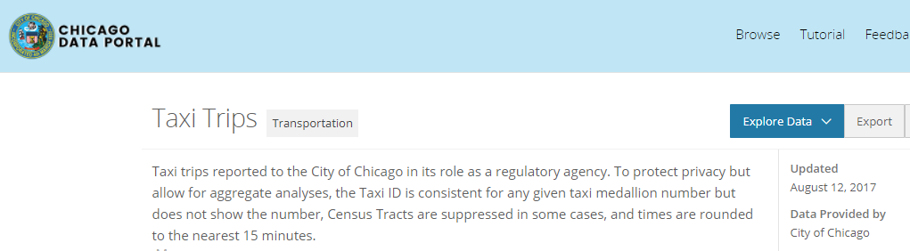
Background/Related Work
Data set published by Kaggle
For 2016 only
Kaggle’s data set replaces lat/lon with ‘community areas’. Makes it more difficult to perform the analysis around pick-up/drop-off locations
Data set contains many other metrics, such as fare, trip distance, trip duration, etc.
Kaggle consumers have used this to analyze many things, such as rush hour heat maps, fare vs. ride time, etc.
However, not a lot around our analysis
The city of Chicago keeps a continuously updated data set
2013 through Aug. of 2017
Maintains a dashboard of the data
Trip volume, duration, fare, drop-off/pick-up
https://data.cityofchicago.org/Transportation/Taxi-Trips-Dashboard/spcw-brbq
Many other data sets on this portal besides taxi rides: Admin/Community/Education…
Very interesting!
https://data.cityofchicago.org/

Slide 4
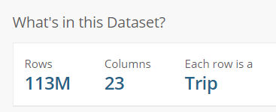


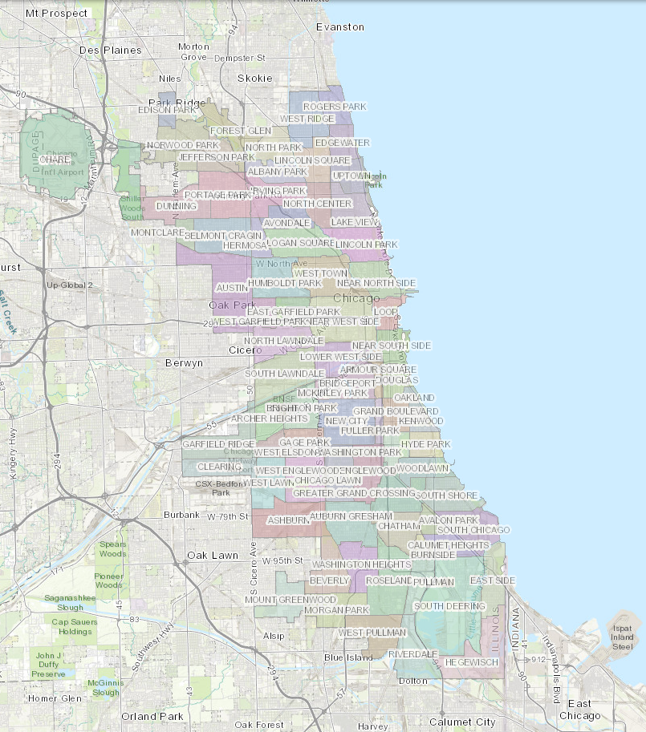
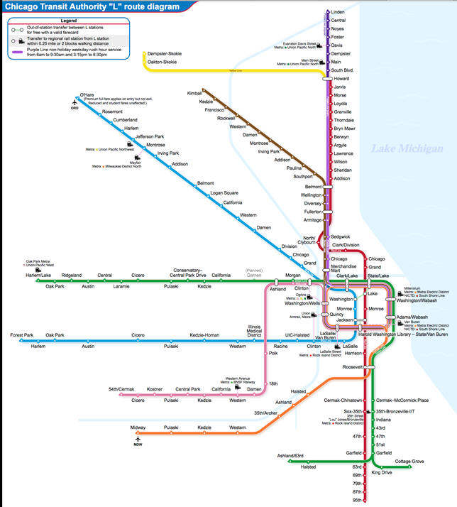
Introduction
BIG data! Very difficult to wrangle
List of columns with definitions in Appendix A
Chicago downtown center
8 rapid transit lines of the city, a.k.a. “L” lines

Slide 5
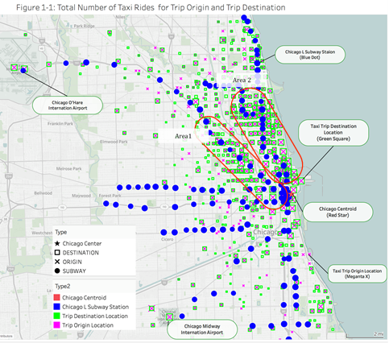
Analysis
Figure 1-1 displays the Chicago map with Chicago “L” Subway Lines station, trip origin, and trip destination
If taxis were complementing “L” routes, we’d expect to see a large concentration of drop-offs and pick-ups corresponding to the “L” terminals. However, Figure 1-1 shows the drop-offs and pick-ups in bands that are perpendicular to the “L” terminals
This suggests that taxis are detracting from “L” terminal business
i.e., taxi passengers are using taxis to get directly to specific locations

Slide 6
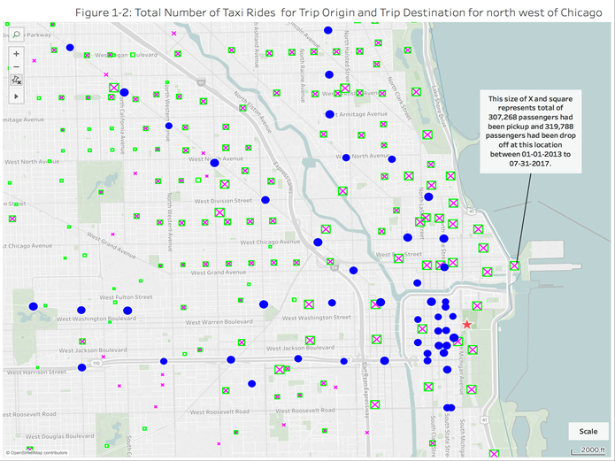
Analysis (cont’d)
Figure 1-2 displays the zoom area for Chicago north east region with map scale of 2000 ft. Most of locations for taxi pick up and drop passengers are a good distance away from “L” line station
The locations of taxi drop and pick off passenger are evenly distributed on the downtown area, especially the areas not covered by a subway station
This is a further indication that taxis are not covering similar routes as the “L” stations, but are detracting from “L” lines by getting people directly to and from downtown

Slide 7
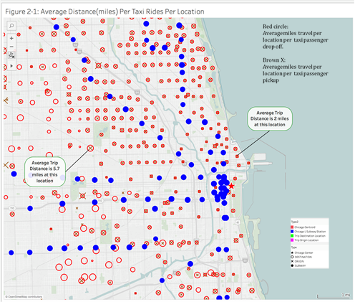
Analysis (cont’d)
Figure 2-1 displays the average distance traveled at each location for each passenger origin and destination. A bigger x or circle represents a longer distance traveled.
The data shows short trips around 2 miles average distance in the region of Chicago downtown. This is an indication that passengers use the taxi for short trips for the areas in downtown that are not covered by the subway.
This also supports the evidence in the previous two figures that taxi and “L” line routes are competing with each other (i.e., detracting).

Slide 8
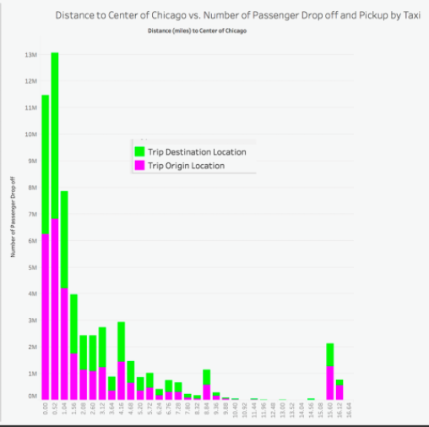
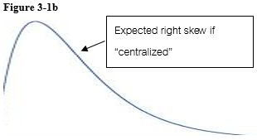
Analysis (cont’d)
Figure 3-1a
Figure 3-1a shows a histogram of average distances from Chicago centroid in ½ mile increments along the x-axis and frequency of passenger drop-offs (in thousands) along the y-axis
If passenger drop-offs were “centralized”, then we would expect to see a heavy right skew in Figure 3-1a similar in shape to Figure 3-1b
From Figure 3-1a we see that the histogram does in fact show the skew that would be expected if Chicago is “centralized”

Slide 9
Conclusion
This analysis leads to two conclusions
Is Chicago “centralized”?
There is strong evidence from the previous slide in Figure 3-1a to suggest that Chicago is in fact “centralized”
Are taxis competing with “L” line transit routes, or are taxis complementing “L” line transit routes by taking passengers to and from “L” terminal stations?
There is moderately convincing evidence from figure series and 1 and 2 that passengers are using taxis to get directly to specific locations downtown and therefore taxis seem to be competing rather than complementing “L” line transit routes

Slide 10
References
Kaggle link to data set: https://www.kaggle.com/chicago/chicago-taxi-rides-2016/data
City of Chicago Data Portal: https://data.cityofchicago.org/d/wrvz-psew
GitHub Link: https://github.com/hdnguyen88/MSDS7330_GroupProject

Slide 11
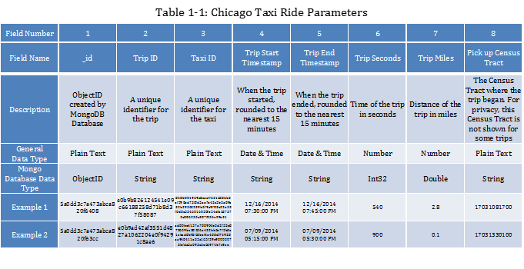
Appendix A

Slide 12
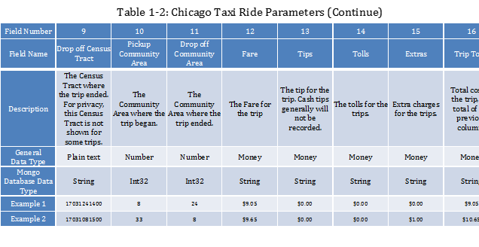
Appendix B

Slide 13
Appendix C

